Slide 1
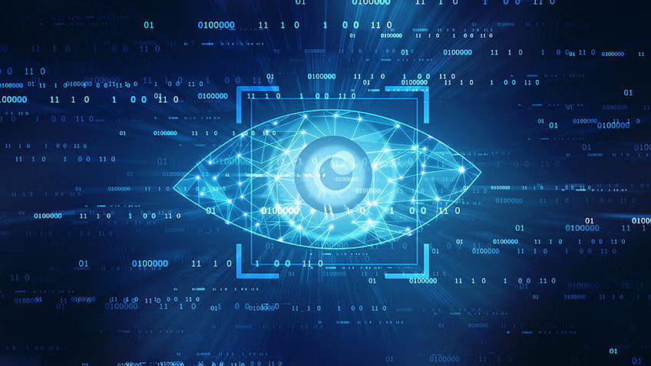
IEEE
computer vision committee
Road map

Slide 2

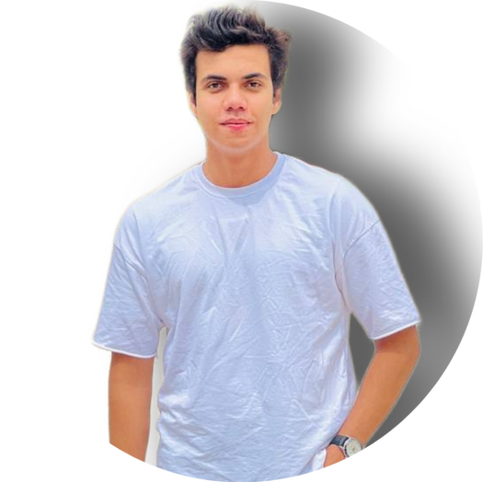
IEEE
Hello guys
Are you Ready
Head
Vice Head

Slide 3
IEEE
#01
Intro to Deep learning and Computer vision
#02
Image processing using OpenCV and NumPy
Agenda
#03
Intro to CNN
#04
basic of Computer vision
#05
Full project in Computer vision

Slide 4
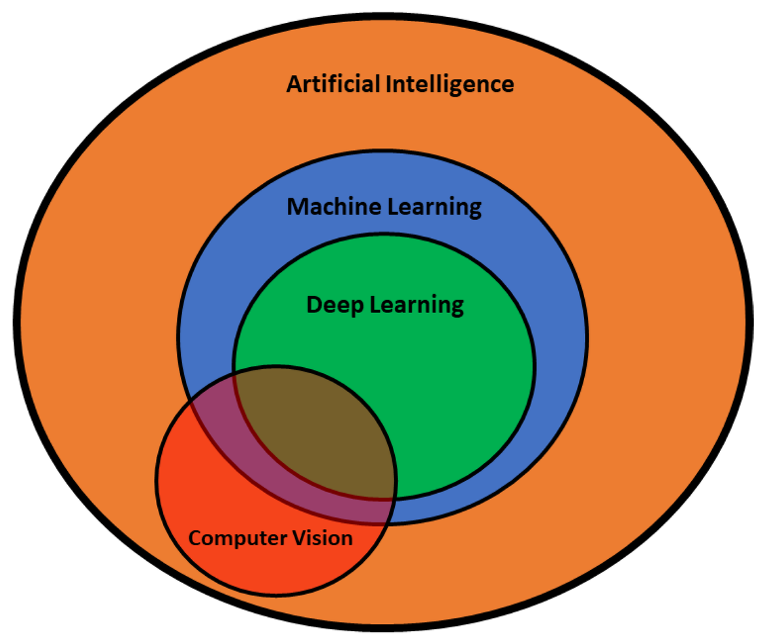
IEEE
Intro to Deep learning and Computer vision
Deep learning is a subfield of machine learning that leverages artificial neural networks with multiple layers to automatically extract complex data representations. It excels in tasks such as natural language processing, image classification, and speech recognition.
Computer vision is an AI discipline focused on enabling machines to interpret and understand visual information from images or videos. It encompasses tasks like image classification, object detection, and facial recognition.
The synergy of deep learning and computer vision, particularly through Convolutional Neural Networks (CNNs), has revolutionized visual recognition. Applications include self-driving cars, medical image analysis, and augmented reality, making our lives safer and more interactive. This collaboration continues to drive technological innovation, enhancing AI's role in various aspects of our world.

Slide 5
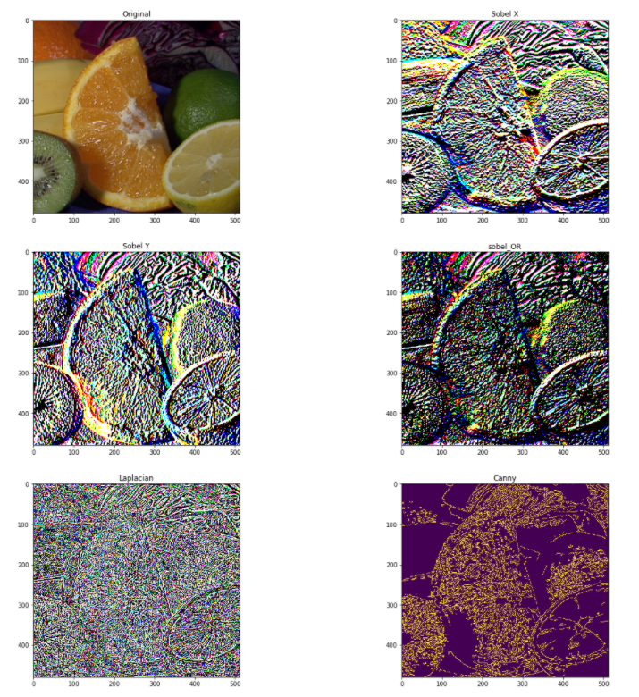
IEEE
Image processing using OpenCV and NumPy
Image processing using OpenCV and NumPy is a powerful combination in Python for manipulating and analyzing images. OpenCV is a versatile computer vision library, offering a wide range of tools for tasks like image loading, filtering, object detection, and more. NumPy, a fundamental numerical library, complements it by providing efficient array operations. Together, they enable developers to read, modify, and analyze images efficiently. You can perform operations like blurring, edge detection, color conversion, and resizing with ease. This dynamic duo is widely used in applications such as image enhancement, object recognition, and computer vision, making it a popular choice for image processing tasks.

Slide 6
IEEE
topics in image processing
Drawing Functions
Thresholding & segmentation
Color detection
Blurring an Image
Reading and Display images & Videos
2.9
2.7
2.5
2.3
2.1
2.8
2.6
2.4
2.2
edges detections
Histograms Equalization & Contrast stretching
Arithmetic operations on Images
Grayscaling of Images

Slide 7
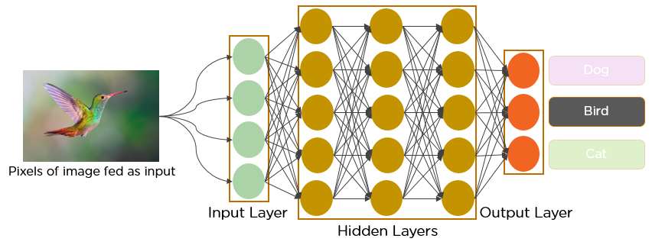
IEEE
Intro to CNN
A Convolutional Neural Network (CNN) is a specialized type of deep neural network designed for processing and analyzing visual data, making it a cornerstone of computer vision and image-related tasks. CNNs automatically learn and extract features from images by using convolutional layers that apply filters to capture patterns like edges and textures. Pooling layers reduce spatial dimensions, making the network translation-invariant.
CNNs are characterized by parameter sharing, which allows them to use the same set of weights and biases across different regions of the input data, enhancing generalization and reducing the number of parameters. They follow a hierarchical feature learning approach, starting with simple features and progressing to complex, high-level representations in deeper layers.
CNNs are widely used in image classification, object detection, facial recognition, and more. They have revolutionized fields like self-driving cars, medical image analysis, and augmented reality. Their ability to automatically learn and recognize intricate visual patterns has made CNNs an essential tool in modern artificial intelligence and deep learning, shaping the way we interact with and understand the visual world.

Slide 8
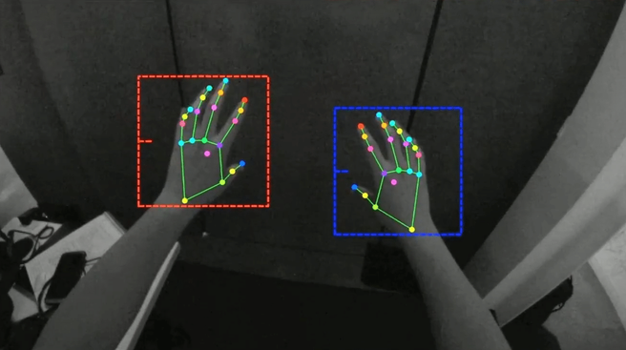
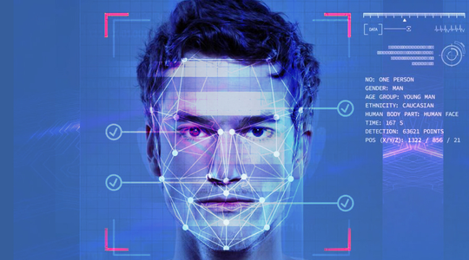
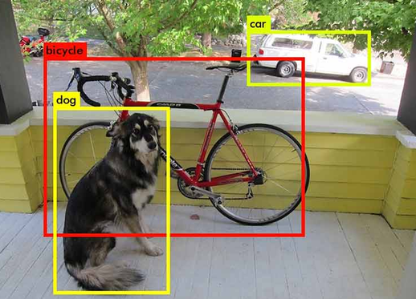
IEEE
basic of
Computer vision
Hand tracking
face recognition
Object detection
Hand tracking is a computer vision technique that detects and monitors the movement and position of a person's hands within an image or video for interactive applications.
Face recognition is a biometric technology that identifies and verifies individuals by analyzing and matching facial features, often used for security and authentication purposes.
Object detection is a computer vision task that involves locating and classifying objects within images or video streams, enabling automation in various applications

Slide 9

IEEE
Full project in Computer vision
it is up to you
Thank you
by Ahmed Fahmy

